Slide 1


GUIDELINES ON APPLICATION FOR INDIVIDUAL IMPORT PERMIT DURING COVID-19 SITUATION

Slide 2






1
Assign a Forwarding Agent (FA) registered with
the Royal Customs and Excise Department (RCED)
2
Complete the Trader Authorisation Form* and email to
coa.renew@customs.gov.bn
(with subject title: Assigning Customs Agent)
3
FA applies for import permit through the
Brunei Darussalam National Single Window (BDNSW) after approval is given by JKED
Pay online and email payment receipt to:
plantimport@agriculture.gov.bn, cc: plantbios@gmail.com
(Plants and Plant Products)
Or
animalimport@agriculture.gov.bn, cc: animal.qu@gmail.com
(Animals and Animal Products)
4
5
For exporting country Malaysia (Sabah & Sarawak):
Receive Import Permit via email
For other exporting countries:
An appointment will be set up via email to collect the import permit over-the-counter
*Download the “Trader Authorisation Form” from the link below:
https://tradingacrossborders.mofe.gov.bn/Downloadable/Trader%20Authorisation%20Form.pdf

Slide 3

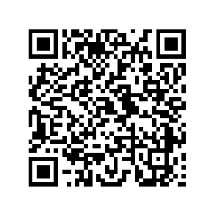

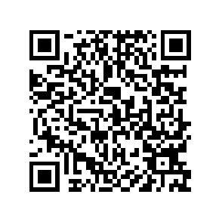
“TRADER AUTHORISATION FORM”
https://tradingacrossborders.mofe.gov.bn/Downloadable/Trader%20Authorisation%20Form.pdf
“LIST OF REGISTERED FORWARDING AGENTS”
https://tradingacrossborders.mofe.gov.bn/Downloadable/List%20Of%20Forwarding%20Agent%202020.pdf

